Slide 1
Network Engagement Team
Supporting NE analysis and application
Release of the information in this briefing does not imply any commitment or intent on the part of the U.S. Government to provide any additional information on any topic presented herein.
THE OVERALL CLASSIFICATION OF THIS BRIEF IS UNCLASSIFIED

Slide 2
Network Engagement Training
Understand and Shape the human domain
Network Engagement Training is a TRADOC led initiative, supported by JNTC, to provide units tailored / OE-focused human network staff training
Network Engagement (AtN)
Network Data Training (SNA/ANAT/NDT)
Provides methodology for developing staff recommendations and plans to shape the human domain in the operational environment (OE)
Partner, Engage, Counter
Rapidly ID Key Nodes
Network after Impact
NDT improves COA Dev and Targeting. It enables the staff to apply social network analysis tools & concepts in order to rapidly identify key network nodes (relevant actors) that could be engaged to yield effects IAW the commander’s desired end state.
Exercise Support & Home Station Training
Advise & assist staffs on emerging OE focused network engagement planning and targeting activities
Maneuver Combat Training Centers (CTC)
Train & Mentor unit staffs
Theater, Service & Multi-National
Exercise / INTELEX Support & Mentoring
Foundry GEN 305 Course
Integration of Network Engagement Doctrine and Processes to support COA Dev and Wargaming
Targeting at the CTCs
Joint;
JP 3-25 CTN
JP 3-15.1 C-IED
JP 3-24 COIN
JP 3-26 CT
Army; ATP 5-06
Network Engagement
Victory Starts Here!

Slide 3
Objectives: Network Data Focused Training, Workshops and Support
Network Analysis course objective(s); to provide team members the knowledge and skills necessary to apply social network analysis (SNA) to kinetic and non-kinetic targeting. This knowledge of network engagement methodologies aids in understanding complex networks in one's operational environment.
These courses are tailored for a variety of unique team members who conduct human engagements or process / use data and information in the course of their mission requirements. Our goal is to provide students with the ability to gather and report relevant actor (network) information, receive and act upon requirements derived from network engagement methods, and assess specific effects of operations to support, influence or counter relevant actors in a given operational environment.
3
Notes:
Source: Course Objective Slide developed from unclassified data by OEC NET Division - training product under TRADOC auspices. Unclassified. No release caveats.

Slide 4
Agenda
Leader Development / Senior Leader Overview
Basic Network Analysis Course (team level)
Network Data Training (practitioner level)
Advanced Network Analysis and Targeting Course
Data Workshop
Train the trainer (T3)
Notes:
Source: Agenda Slide developed from unclassified (notional) data by OEC NET Division - training product under TRADOC auspices. Unclassified. No release caveats.

Slide 5
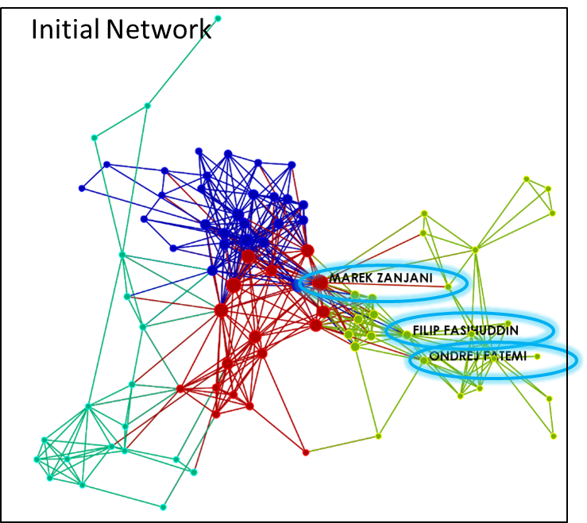
I. Leader Development /
Senior Leader Overview
Target Audience: Senior Leaders / Teams involved in planning and executing expanded maneuver and information warfare activities.
Duration: 1 to 2 hours *
Description: provide the audience with a deeper understanding of the network engagement methodology and the central role that relational data and information can play in shaping plans and influencing the commander’s operational approach when operating across the competition continuum. Our team will demonstrate the process of gathering and reporting relevant actor (human network) information, based upon requirements derived from network engagement methods, and assess specific effects of operations to support, influence
or counter relevant actors in a given operational environment.
* For all courses and seminars -- unit/team data and advance preparation for these sessions is strongly recommended or required (depending on the course).

Slide 6
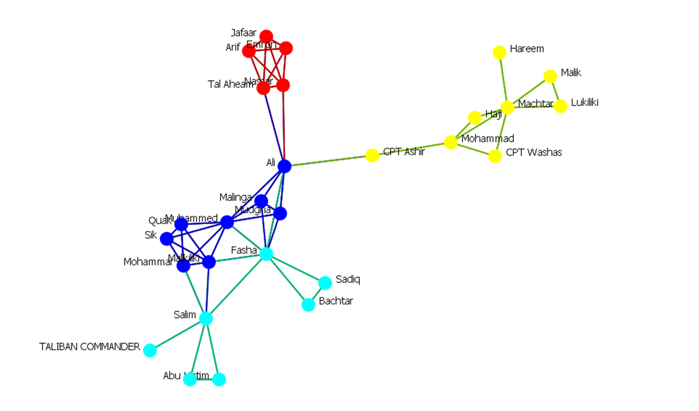
II. Basic Network Analysis Course (team level)
Target Audience: Teams involved in planning
and executing expanded maneuver and information warfare activities – to include human network analysis / civil information
management and analysis of publically available information.
Duration: 2 to 3 days *
Description: provide students with deeper understanding of methods used to gather and report relevant actor (human network) information, receive and act upon requirements derived from network engagement methods, and assess specific effects of operations to
support, influence or counter relevant actors in a given operational environment. The NE Team will demonstrate these methods from raw data to relational data and discuss network analytic methods that support the NE process – including an introduction to social network analysis.
* For all courses and seminars -- unit/team data and advance preparation for these sessions is strongly recommended or required (depending on the course).

Slide 7
III. Network Data Training Course (practitioner level)
Target Audience: Targeting, fires, effects, CA/PSYOP, SFA, Intel Fusion and others who conduct analysis and create products to support planning, COA Dev, collection and targeting.
Duration: 3 to 5 days *
Description: provide students with the deeper understanding of methods used to better
gather, store, retrieve and report relevant actor (human network) information. This will be a hands-on session and unit specific data / information and advanced
coordination with the training team is strongly recommended.
The training audience will receive and act upon requirements derived from network engagement methods, and assess specific effects of operations to support, influence or counter relevant actors in a given operational environment. The NE Team will demonstrate these methods from raw data to relational data and students will practice network analytic methods that support the NE process – including a deeper dive into social network analysis.
* For this course -- unit/team data and advance preparation for these sessions
is strongly recommended.

Slide 8
IV. Advanced Network Analysis and Targeting Course
Target Audience: Targeting, Fires, Effects, CA/PSYOP (CIM/HNA),
SFA, Intel Fusion and others who fuse data / information / intelligence, conduct analysis and create products – based on social network data – to support planning, COA development & wargaming, collection and targeting.
Duration: 10 days (tailored) – practical ‘Network SOP development’ or T3 sessions available *
Description: provide students with the deeper understanding of methods used to better
gather, store, retrieve and report relevant actor (network) information. This will be a hands-on session and unit specific data / information and advanced
coordination with the training team is required.
The training audience will receive and act upon requirements derived from network engagement methods, and assess specific effects of operations to support, influence or counter relevant actors in a given operational environment. The NE Team will demonstrate these methods from unit/team data and students will practice network analytic methods that support the NE process – including a deep dive into social network analysis to support network analysis and engagement recommendations.
* For this course -- unit/team data and advance preparation for these sessions is required.

Slide 9
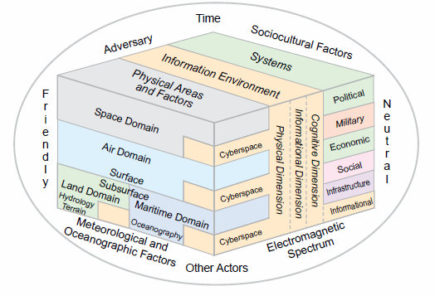
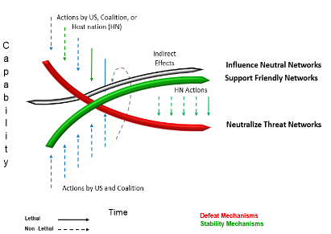
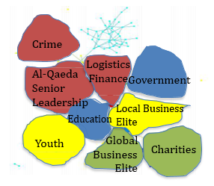
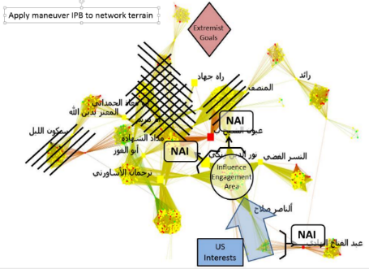
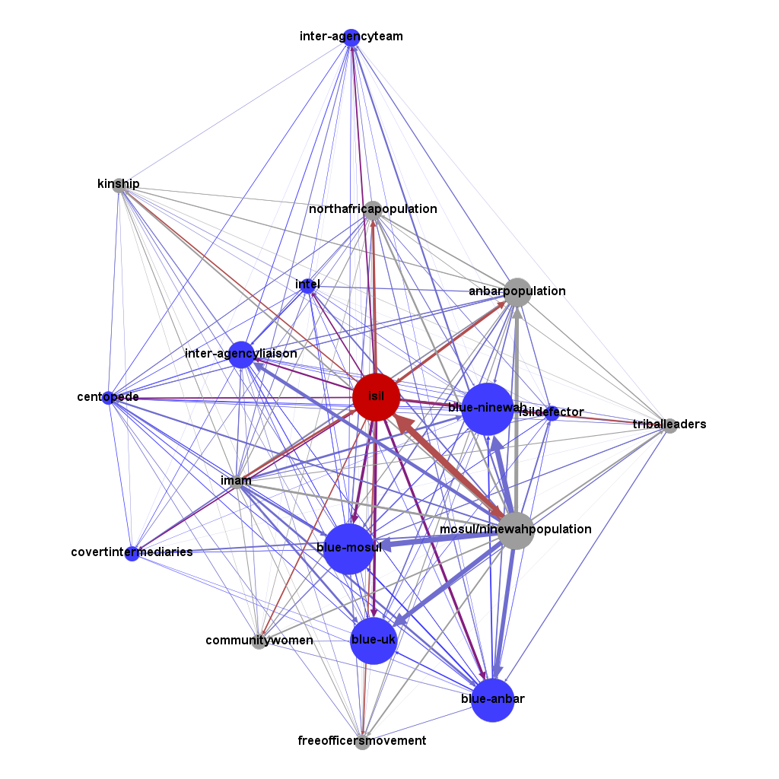
Network Engagement “Cognitive Maneuver”
Analyze
Explore the complex OE
Emerging Doctrine Support
JS J39
CADD
USASOC / SOCOM
Develop
Create Relevant COAs
Apply
JP 2-01.3 JIPOE, May 2014
Apply to Scheme of Maneuver
Assess Cognitive terrain
Develop Cognitive AoA
Evaluate relevant networks
Ongoing Training:
Army
Joint
Interagency
Multinational
Recently completed development and delivery of a remote training course in collaboration
with the US Army War College titled “Cognitive Maneuver” – tailored training, education, leader development and exercise support (human network / information focused) available.
Notes:
By considering the complexities of the OE, considering relevant COA’s to achieve mission success, human network domain analysis will provide insights into assessing the cognitive terrain that exists in a given OE.
Image sources;
Top Left – JP 2-01.3 JIPOE, May 2014, p. I-3
Bottom Left – Network Engagement Training Team, TRADOC G27 OE TSC.
Top Right – Open Source, Google images.
Bottom Right – JS J39 Strategic Multilayer Assessment (SMA) Periodic Publication, TRADOC G27 NE Team co-authored.
https://upload.wikimedia.org/wikipedia/commons/6/6d/Gephi_0.9.1_Network_Analysis_and_Visualization_Software.png
By analyzing the Cognitive Avenues of Approach, among other key considerations, the staff can develop cognitive maneuver recommendations to better engage and influence the human domain with lethal and non-lethal recommendations.
The heart of these efforts rely on capturing, organizing, storing, retrieving and visualizing human network OE data to apply social network analysis concepts in order to rapidly identify key network nodes that could be engaged to yield effects that conform with the commander’s desired end state.
BACKGROUND Information pertaining to training;
Network Engagement:
Provides methodology for developing staff recommendations and plans to shape the human domain in the operational environment (OE). The objective is to shape the OE by synchronizing lethal and non-lethal actions to neutralize threat networks while supporting friendly networks and influencing neutral networks. The six network engagement topics are applied using the operations process (Plan, Prepare, Execute, Assess) and its supporting and integrating processes (operational design, MDMP, IPB, ISR Synchronization, and Targeting).
NE requires staff integration. It enables the unit to influence the human domain and shape the OE.
NE Pillars are applied using the operations process (Plan, Prepare, Execute, Assess) and its supporting and integrating processes (Operational Design, IPB, ISR Synch, Targeting, and Assessment).
------------------------
ANAT
Provides a methodology and a software tool (Organizational Risk Analyzer (ORA) software suite) that enable units to rapidly identify potential high value targets by adding a layer of analysis. The methodology applies social network analysis concepts in order to rapidly identify key network nodes that could be engaged to yield effects that conform with the commander’s desired end state. This training directly supports and complements NE training.
Image sources;
Top Left – JS J39 Strategic Multilayer Assessment (SMA) Periodic Publication, TRADOC G27 NE Team co-authored.
Bottom Left – JS J39 Strategic Multilayer Assessment (SMA) Periodic Publication, TRADOC G27 NE Team co-authored.

Slide 10
Network Engagement Contact Information
TRADOC G-2 Network Engagement Team Lead:
Chris Worret
Email: christopher.j.worret.ctr@mail.mil
Office: (757) 878-9660
TRADOC G-2 OEC Operations:
Mr. John Wrann
Email: usarmy.jble.tradoc.list.hq-tradoc-g-27-operations@mail.mil
Office: (757) 878-9564 / 9503 / 9696
Web Portals:
NIPR: https://oeenterprise.army.mil http://www.tradoc.army.mil/g2/oetsc/default.aspx

