Slide 1
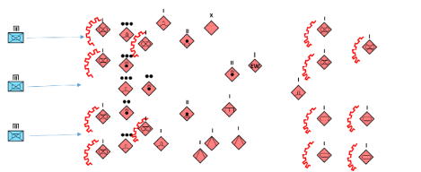
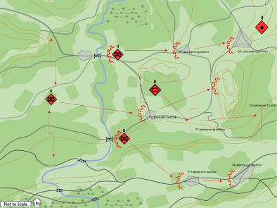
How They Fight Series
(U) Russia: Defensive Operations
(U) This infographic describes and depicts SV defensive operations. Over the course of the last two decades, the Ground Forces of the Russian Federation (SV) have emphasized defensive tactics. And, while SV units train in both positional and maneuver defense, recent SV doctrinal papers have emphasized the value of the maneuver defense over the positional defense. In all cases however, the SV considers the tactical counter-attack as the ultimate method for destroying an aggressor on the battlefield. The SV is not the ground force of World War II or the Cold War, which involved massive armies and millions of soldiers in a linear, cohesive, side-by-side defense. Indeed, contemporary Russian military writers suggest that the future conventional battlefield under nuclear-threatened conditions and precision weapons will be fragmented. The SV will fight with open flanks protected by fires, counterattacks, strong points, difficult terrain and obstacles. Battles in the security zone combined with maneuver defense will be common leading to a positional defense where the greatly weakened and disorganized aggressor will crash into a toughened and prepared defense.
(U) The goals of the defense include: Repelling attacks by a superior aggressor, producing maximum losses on the aggressor, holding important areas, and key terrain, and generating advantageous conditions for the conduct of an offensive.
X
(U) Positional Defense
(U) Maneuver Defense
Motorized-Rifle Brigade
3,000 – 4,500 Troops
I I
Per BN
BTR – 539pax, 44 BTR-80/82/MT-LB
9 ATGM, 8 1(20mm )MTR, 6 AGS-17
or
BMP – 461pax, 37 BMP-2/BMP-3, 8 (120mm) MTR, 6 AGS-17
I
Sniper teams equipped with laser sights, ballistic computers, automatic rifles, and long-range rifles of foreign manufacture
I I
I
3 Orlon-10 drones
I I
151pax, 31 – T72B3/T80/T90/T14
I
Per BN
211 pax, 18 SP Howitzer (152mm)
EW
100pax, Jamming of HF, Ground & Air VHF, GMRS, GPS
I I
I
18 BM-21 MRL (122mm)
~70pax, 1 TOS-1A, 60 RPO Shmel
I I
10 TIGR/TIGR-M, Radars – KREDO /SNAR-10 & Seismic sensors
I I
(U) The SV recognizes two types of defense: positional and maneuver. The positional defense is designed to exact the utmost losses on the aggressor by tenaciously holding prepared defensive positions. The positional defense is used to defend critical terrain and significant objectives considered too important to lose to the aggressor. An SV positional defense will be significantly echeloned by a system of defensive positions, lines and areas and a prepared system of planned and integrated fires designed to defeat the aggressor. SV units may also adopt a brief positional defense, typically a non-fortified firing line. This temporary defense could be employed during a meeting battle or while moving within a defensive combat formation. Typically, the temporary positional defense is used to fend off aggressor counterattacks, hold key terrain, or to protect exposed flanks before shifting to offensive operations. SV manuals stipulate that a brigade’s main defensive zone in a positional defense will be up to 15 kilometers wide and up to 20 kilometers deep. As always, though, the width and depth will be situationally dependent.
LMA
12 SA-15
6 SA-13, 6 SA-19, 27 SA-18
LMA
I I
6 MT-12 with MT-LB
24 AT-15 Springer on BMP or AT-14 Spriggan
I I
Construction & Mobility – TMM-3, BAT-2, UR-77, GMZ-3, UR-83 and PP-91 bridge.
(U) When circumstances arise in which the aggressor has substantial advantage over SV forces, and when it is possible to trade space for time, the SV will use a maneuver defense. Maneuver defense is designed to win time, allow for the reorganizing of forces, and at the intended time, strike a critical blow on the attacking aggressor. In short, the maneuver defense is achieved by echeloned, sequential defensive actions planned in advance, and culminating in a decisive blow against the aggressor forces. A brigade’s main defensive front in a maneuver defense can be up to 20 kilometers wide, and up to 30 kilometers in depth. However, the width and depth of the main defense will be situationally dependent.
I I
Satellite, HF, VHF
I I
SPT
1,000 pax – Evacuation, Transport Fuel-Ammo-Supply-Material, Supply & Maintenance
(U) The preparation and formulation of the defense starts when the SV senior commander issues his orders. These orders include: organization for combat, decision making, giving orders to subordinate units, reconnaissance, establishment of cooperation and establishment of an integrated system of fires, as well as, wide ranging logistic and C2 support, development of diagrams for the battalion’s area of defense, to include company strong points, planning to conduct combat missions, creation of combat orders and system of fires, engineering collaboration for the establishment of strong points, organization and direction of morale and psychological effort, and the functional work by the commander, deputies, and staff with subordinate subunits and other planning activities.

