Slide 1
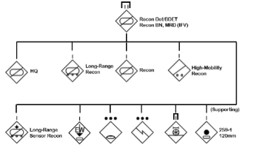
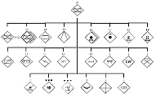
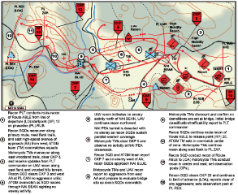
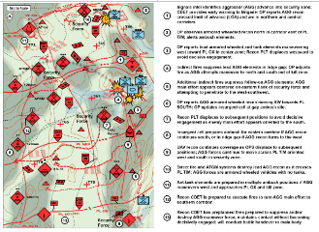
How They Fight Series
(U) Russia: SV Motorized Rifle Regiment Reconnaissance Operations
(U) This infographic describes and depicts Russian army (SV) Motorized Rifle Regiment and subordinate reconnaissance operations. Reconnaissance and Counter-reconnaissance represent the most important aspects of SV operations. The SV frames reconnaissance in much the same way as the U.S. Army and considers reconnaissance an all-arms operation.
(U) Russian reconnaissance and security are on-going actions regardless of the type of competition, crisis, or conflict. The SV uses all forces and means available to conduct reconnaissance to gain information on the battlefield as well as security actions to deny an aggressor information and understanding of the SV’s forces. The Russian military recognizes the critical need to obtain battlefield information through reconnaissance and security to maintain freedom of action for its forces. Reconnaissance and security are essential to creating and sustaining situational awareness and understanding of an operational environment including friendly and aggressor forces, potential adversaries, and civilian populations.
(U) SV Rifle Regiments
(U) Reconnaissance Battalion, Mech Div (IFV)(Example)
(U) For tactical offensive and defensive actions, SV reconnaissance missions are usually grouped in the categories of combat reconnaissance, signals intelligence, radar, electro-optical, artillery, engineer, medical, route, and NBC. Another category is special reconnaissance typically conducted by special operation forces or other designated forces operating in the depth of an aggressor AOR or at selected sites. Special reconnaissance supports operational and strategic operations. The typical reconnaissance missions are route, area, and zone. During local war and armed conflict operations, SV units and subunits perform a variation on area reconnaissance labeled as a reconnaissance search activity. Reconnaissance actions include: observation, infiltration, search, raid, ambush, and reconnaissance by battle.
(U) Security forces are assigned an AOR in support of a force to be protected with adequate space and distance to provide early warning of an approaching aggressor and prevent aggressor ground and air forces from observing or engaging the protected force with direct fires. Protecting a force from aggressor indirect, aviation, and missile fires is problematic due to the various types of long-range weapon complexes that are available to an aggressor. The intent of security missions is to provide effective early warning and protection actions that support SV unit freedom of action and maneuver in the conduct of a mission. Capabilities are a combination of cyber, space, ground, and manned and unmanned aerial resources and sensors. Security missions are screen guard, cover, and reconnaissance defeat.
(U) The SV motorized or tank division is organized with a separate reconnaissance battalion with significant capabilities. Brigades will also contain a reconnaissance battalion in their force structure.
(U) The reconnaissance battalion of a SV mechanized division, with modernized infantry fighting vehicles (IFV), has the subunit functions presented below. Other maneuver battalions have similar reconnaissance assets. Additional capabilities, as in the example, are often task-organized to the battalion based on mission requirements.
Motorized Rifle Regiment
Motorized (Mech) Rifle Brigade
Reconnaissance battalion, mechanized division (IFV)(Example)
(U) Russian SV situational awareness and understanding are products of razvedka—the Russian term that encompasses reconnaissance, intelligence, surveillance, and target acquisition. The SV continues to refine its integrated complex to collect information, create and update timely intelligence, and direct units and complexes to monitor, target, and strike an aggressor at an advantageous time and location. All levels of command in the SV are responsible for conducting razvedka, in all situations and circumstances. Razvedka can be strategic, operational or tactical; however, all three levels are closely interconnected. An attack with fires will often require near real-time or immediate execution to achieve effective results and razvedka forces and means provide the necessary precision target acquisition to support those strikes. The razvedka complex also provides subsequent data and analysis to estimate and/or confirm the expected damage assessment on targets.
(U) The reconnaissance brigade (разведывательная бригада - razvedyvatel'naya brigada – Pb) is a separate brigade at the operational echelon and has capabilities that can be selectively task-organized to support tactical actions. The SV currently has a limited number of Reconnaissance brigade forces operating in or beyond a tactical force’s AOR which can include long-range reconnaissance, long-range sensor reconnaissance, intelligence and electronic warfare, mounted and dismounted reconnaissance. When directed the Pb can augment capabilities with selective mechanized, armor, antitank, artillery, air defense, sniper, and/or engineer support. Aviation and air assault forces, and extensive UAVs of a reconnaissance brigade can also be allocated to support of tactical actions.
Route Reconnaissance
Screen with a Reconnaissance Company
(U) Special reconnaissance includes reconnaissance and surveillance conducted as a special action in hostile, denied, or politically sensitive environments to collect or verify information of strategic or operational significance. This type of reconnaissance usually employs military capabilities not resident in regular SV forces. The most widely known special reconnaissance activity is the General Staff Main Intelligence Directorate (GRU) Spetsnaz (спецназ). Spetsnaz are not equivalent to US Special Forces and are primarily focused on intelligence collection. Spetsnaz as a term includes any specialized unit with a narrow area of specialization like signal intelligence, engineering, is experimental, or performs highly important tasks.
(U) Each military district has a Spetsnaz brigade that functions as district-subordinate scouts. To conduct signal intelligence collection each military district has a SIGINT or OSNAZ brigade.

