Slide 1
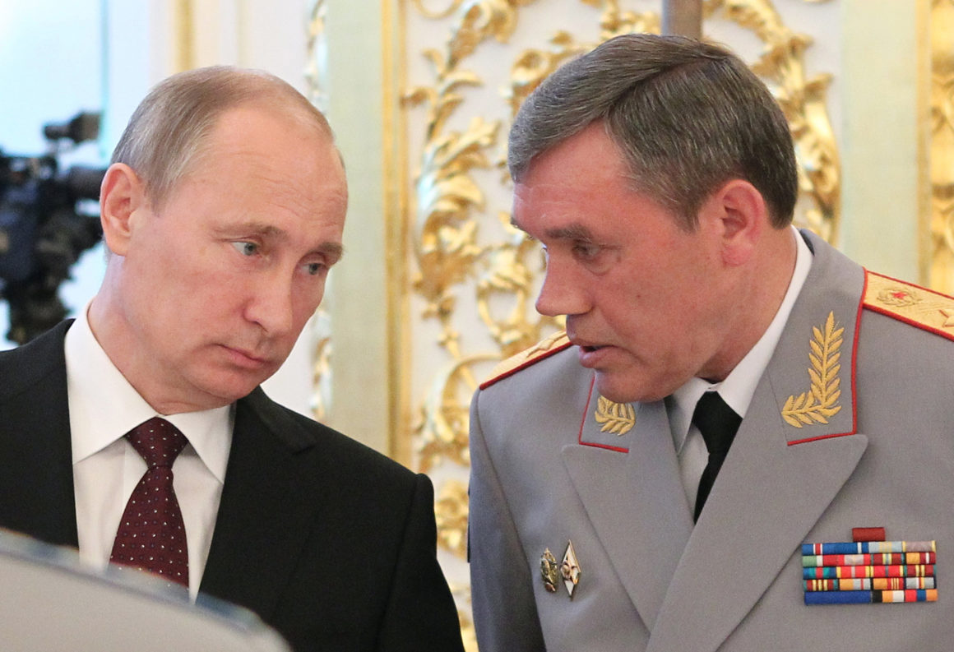
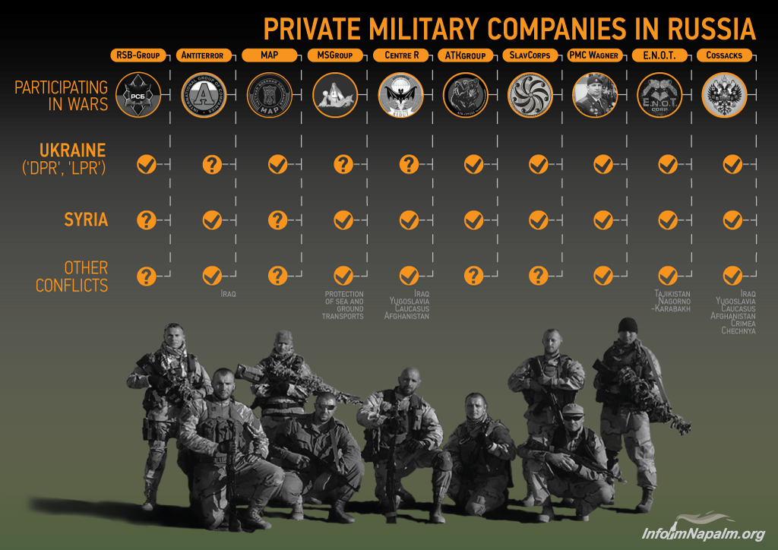
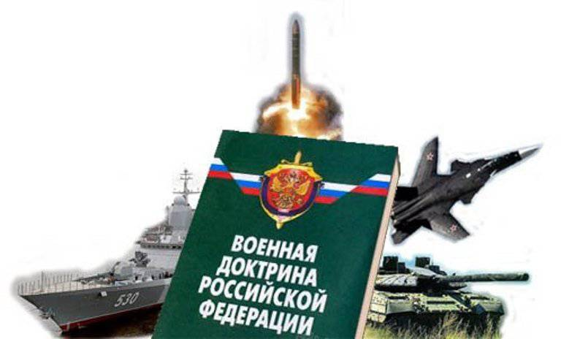
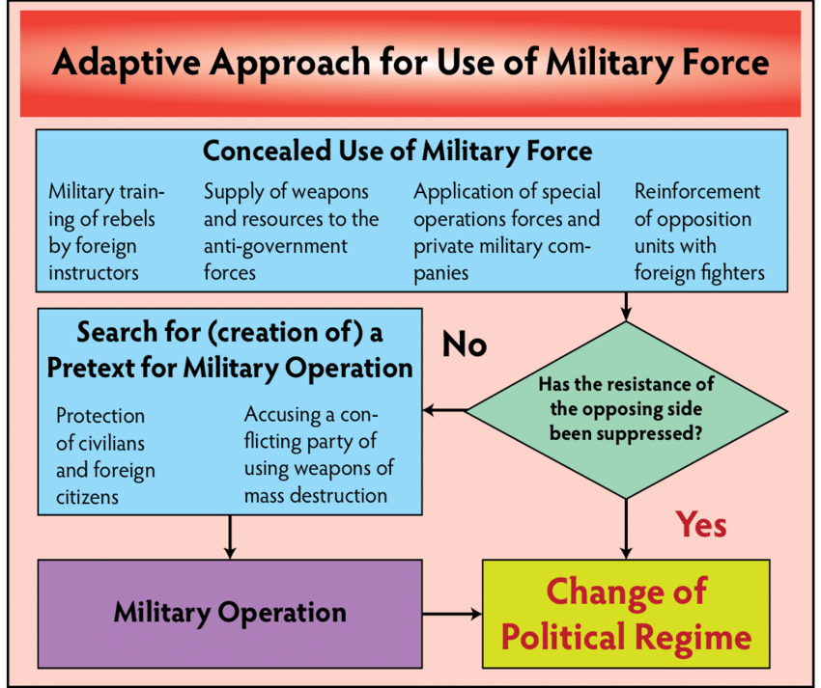
Russian Armed Forces Hybrid Warfare Doctrine
“Gerasimov Doctrine” since at least 2008
Constant “war footing”… continuous competition
Use of Hybrid methods to defeat adversaries asymmetrically
Ratio of non-military to military action is 4:1
Maintain plausible deniability
Maintain strategic nuclear deterrence to underpin actions
Newest (public) Military Doctrine published in 2014
Focus on defense & protection of its territory and resources
Eludes to engagement in their “near abroad”… looks for pretext for operations
Russia publically maintains a defensive military doctrine while privately employing asymmetric tactics to achieve advantages over its adversaries

