Slide 1
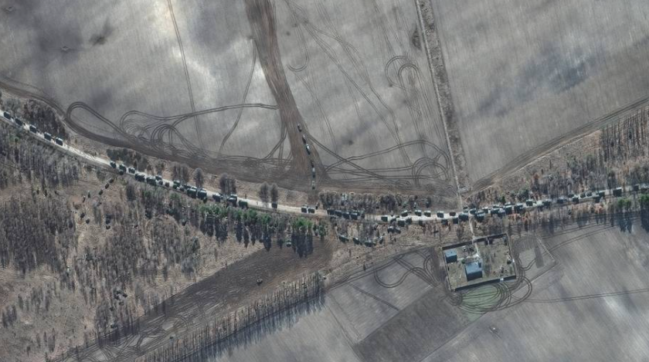
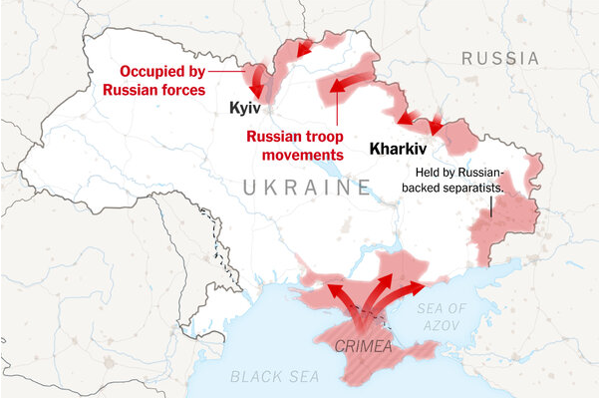
ICOD: 02 0900 Mar22
Threats and Adversaries
Competition & Crisis…Conflict In Real Time
Diplomatic:
Ukraine and Russia held initial talks
PRC balances between Russia and West
Information:
Google, Facebook, and Twitter battlespace
Military:
Belarus prepared to join Russian invasion?
EU to send lethal aid to Kyiv
Fuel tanker are priority targets of Ukraine
Economic:
Forty mile long Logistics jam
West disconnect ‘selected’ Russian banks from SWIFT
Ruble plummets as much as 40%
70% of Russian forces are inside Ukraine
Ukrainian resistance has delayed Russian advancement on major cities

Slide 2
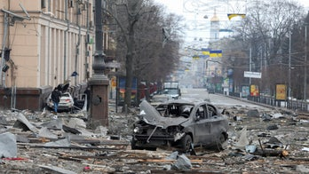
Threats and Adversaries (Cont)
Russian approach to urban areas…
Not meeting objectives in three major urban areas
Kiev, Kharkiv, and Odessa
Changing tactics in population centers
Blokirovanie (blocking tactics) to support maneuver and population control
TOS—1 (220mm x30 MRL)
WEMD & SOMD Cdrs were architects of Aleppo siege in Syria
Tactics carrying over to Ukraine mission
Transitioning weapons and munitions
Precision to area effect munitions (Conventional, DPICM, Thermobaric)
Introducing high-power weapons (2S7 203mm HVY ARTY, 2S4 240mm HVY Mortar, TOS-1a 220mm x30 MRL)
Attack in Kharkiv
Re-emergence of the Artillery Army with Tanks

