Slide 1
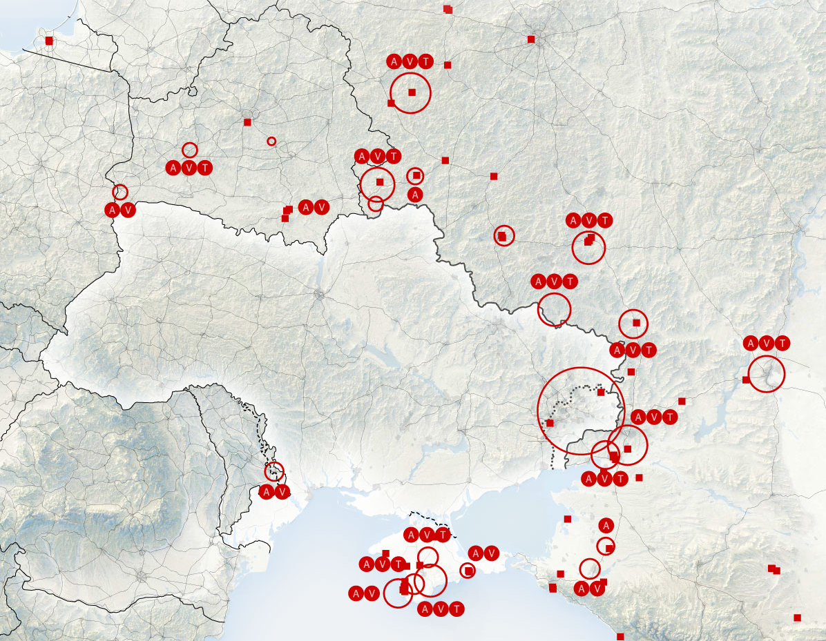
ICOD: 8 1000 Feb22
Threats and Adversaries
“Competition” in Real Time
Diplomatic:
Russia denies Putin reached deal with French President
Information:
Russia and China announce pact against the United States
Ukraine to unleash “bloody hell”
Military:
86 BTG Russian build up continues…
Medical indicator tripped
Economic:
Germany- “Everything [Nord Stream] is up for discussion”
Russia Military Situation
Belarus
Russia
Poland
Ukraine
Romania
~130k of anticipated ~175k troops … 70%
Additional 30K in Belarus
20,000+ Air & Naval Forces postured to support
Russia postured…Diplomatic breakthrough unlikely, Crisis?

Slide 2
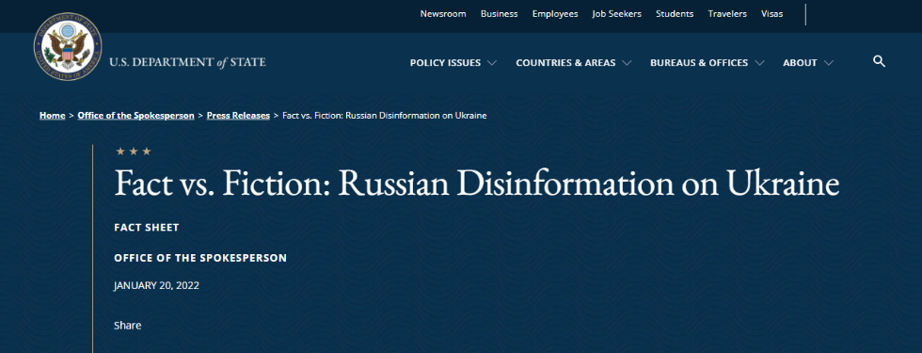
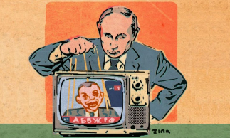
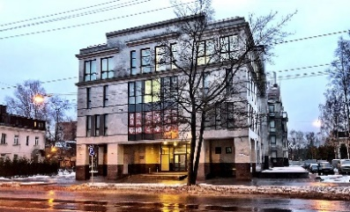
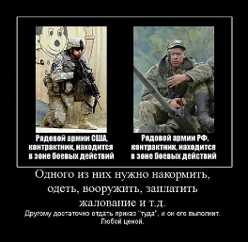
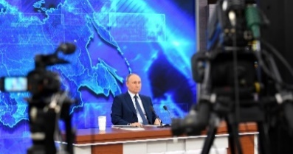
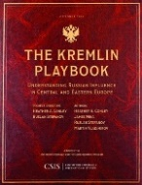
ICOD: 8 1000 Feb22
Threats and Adversaries (cont.)
Russian Information Confrontation
Components and Changes:
'Radioactive Ash‘
"Russia is the only country in the world that is realistically capable of turning the United States into radioactive ash," – Dmitry Kiselyov
Disinformation Infrastructure in Place
Russia-linked social media quick to pick up rhetoric and misleading claims
A Shift in Tone
Anti-Ukrainian rhetoric given way to defensive posture, negotiations and "national security" interests
New Main Target Is NATO, Not Ukraine
Softening of the Russian media's tone toward Ukraine
Russians Tired of Warmongering
Hate-mongering tactics becoming less effective at home
Getting in front of Russia Dis/Mis information
Russia Information Operations challenging reality while invasion seemingly inevitable

