Slide 1
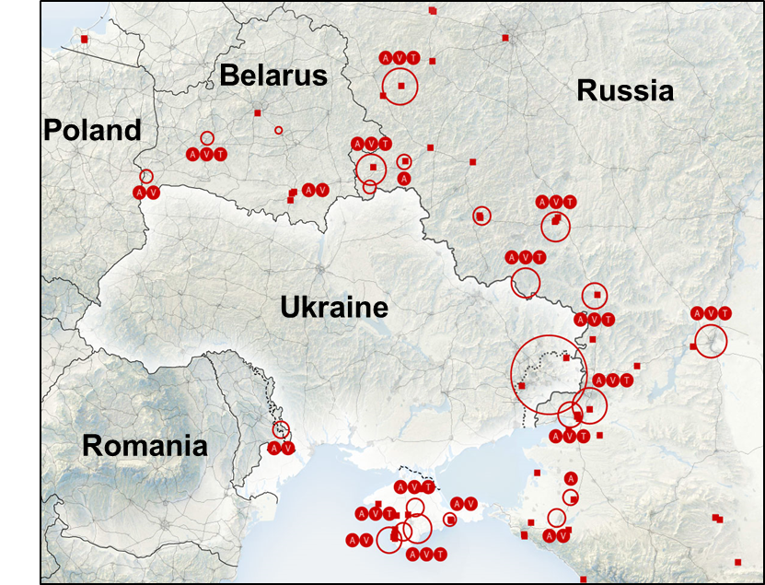
ICOD: 22 0900 Feb22
Threats and Adversaries
Competition In Real Time
Diplomatic:
Russia has recognized the independence of two separatists regions in East Ukraine
Information:
President Putin amplifies attempts to pretext Russian invasion of Ukraine
Military:
Russia deploys “peacekeepers” into Eastern Ukraine
Economic:
Germany has taken steps to halt the Nord Stream 2 gas pipeline
Sanctions against Russian banks and Putin’s inner circle
Russia Military Situation
~130k+ of anticipated ~175k troops … 80%
20,000+ Air & Naval Forces postured to support
Russia is at war with Ukraine and whoever opposes

Slide 2
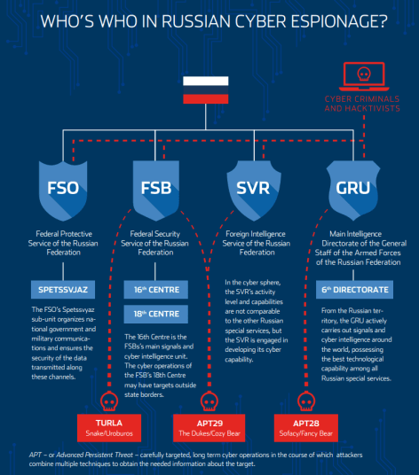
ICOD: 22 0900 Feb22
Threats and Adversaries (cont.)
Russian Cyber Operations…
In Competition & Crises
What we saw…
“Web war” – Estonia 2007
Cyberattacks ICW with military operations - Georgia 2008
Cyberattacks against Ukrainian power grid in 2015 & 2016
Demonstration attacks? against Colonial Pipeline and meat processor, JBS USA…Solar Winds
What we are seeing…
Destructive Malware disguised as ransomware
Shaping Cyberattack against Ukrainian government sites, "be afraid and expect the worst"
What we anticipate…
Disruptive or destructive cyberattacks against Ukrainian air control and rail networks, media, energy & communications sectors…weapons systems?
Attacks against western financial institutions?
Russia Cyber Components
Russia is using cyber to shape the potential battlefield. If crises occurs, expect destructive attacks on Ukraine… potential retaliation against the West

