Slide 1
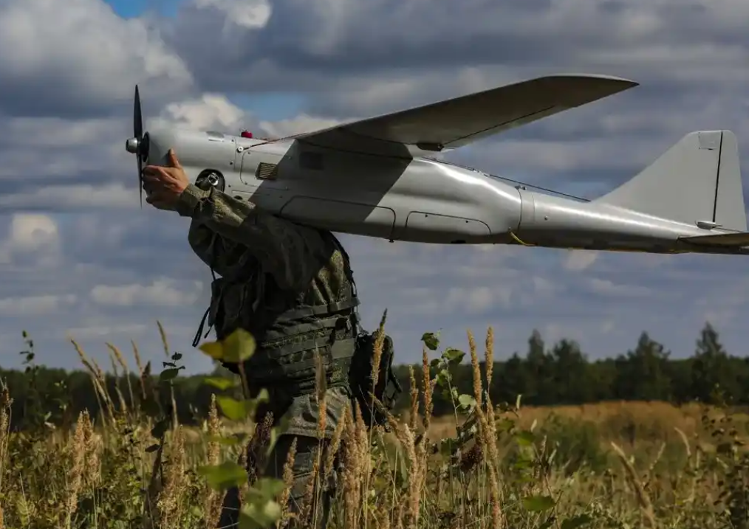
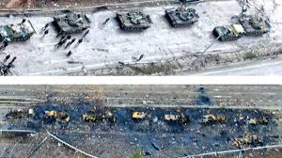
ICOD: 29 0900 Mar22
Threats and Adversaries
Use of small, ‘cheap’, disposable and highly
lethal systems
Early use of RUS UAVs was limited…RUS now operating UAVs as expected at the onset
Orion ATK UAV carries four warheads (200Kg total)
Orlan-10 & Takhion-4 tactical IS&R
Eleron-3 & Granat close range IS&R
Leer-3 EW & cellular
RUS Orlan-10 UAV
Used for Reconnaissance, strike, and targeting
Ukraine actively using UAVs since start of conflict
Turkish TB-2 with micro munitions
Other indigenous, Polish, Israeli and American UAVs
Effects of Ukrainian UAV strike
Like Syria, Yemen, and in Armenia (& other conflicts) UAVs have become a standard on the battlefield

