Slide 1
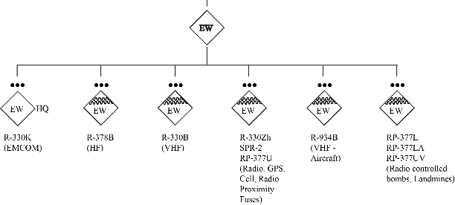
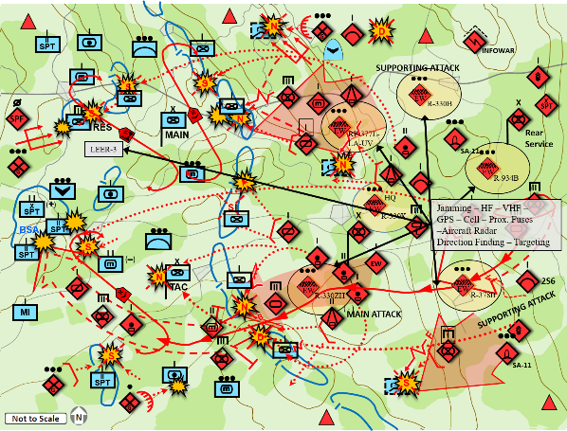
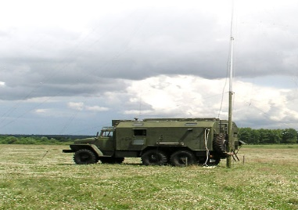
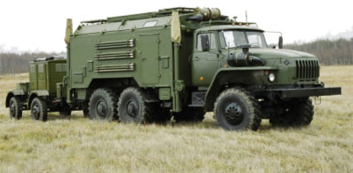
How They Fight Series
(U) Russia: Radio-Electronic Battle (REB) Complexes Company
(U) This infographic describes a Russian radio-electronic battle (REB) complexes company. The reorganization of Russian ground forces resulted in significant increases in its REB capabilities. The new formations included REB brigades for each of the military districts. These REB brigades, with four battalion subunits, maintain the most modern and powerful electronic warfare complexes that provide integrated area coverage as well as support for maneuver actions. Brigades conduct collection and analysis of the EMS in each district during peacetime and are available for immediate support of the corresponding OSK during conflicts. Each of the battalion subunits of a REB brigade focuses on a specific type of electronic warfare defined by its targets.
(U) Russian REB Company
(U) REB Platforms in MRB/TB Maneuver Formation
(U) Descriptions of the REB Complexes Found in the Company
REB Complex | Purpose
RP-330KPK | VHF Automated Command Post
RP-330K | Automated Control Station
R-378B | HF Automated Jamming Station
R-330B | VHF Frequency Jammer linked to the Borisoglebsk-2 HF Automated Jamming Complex
R-330Zh | Automated Jammer against INMARSAT and IRIDIUM satellite communication complexes, GSM, and GPS
R-SPR-2 | VHF/UHF Radio Jammer cover and thereby protect troops in an area of up to 50 hectares for up to 6 hours
RP-377U | Portable Jammer (against IEDs)
R-934 | Automated VHF-UHF aerial radio communication jamming complex provides automated detection, direction finding and signals intelligence of aerial radio sources. It also detects and jams VHF radiotelephone and mobile radio complexes.
RP-377L | IED Jammer
RP-377LA | Portable Automated Jammer
RP-377UV | Portable Automated Jammer
In addition to the REB brigades, a separate REB company was added to each maneuver brigade. The company is tailored to provide tactical level support that provides overall EMS situational awareness, targets and degrades aggressor C2, provides protection from precision-guided munitions (PGM) and improvised explosive devices (IED).
The REB Company subunits integrate into the maneuver formation of the brigade as shown in an example for an offensive action. Just like other SV combat complexes the REB units and subunits provide successive layers of coverage to target the aggressor and protect friendly forces. To disrupt or destroy communication capability of the aggressor units and subunits at the point of contact with SV forces, REB deploys its complexes within 1-3 KM of the line of contact. These units and subunits conduct interception and direction-finding of C2, communications, and radars. At the next level, approximately 15 – 30 KM from the line of contact the REB units deploy complexes that target HF, VHF, UHF, satellite, and GSM cell towers, 3G, and 4G networks. These complexes not only jam communications but also conduct intrusion into enemy communications by introducing psychological warfare messages into aggressor networks.
(U) R-378A High Frequency (HF) Communication Automated Jamming Station
(U) R-934B VHF Air Communication Automated Jamming Station
References:
Worldwide Equipment Guide

