Slide 1
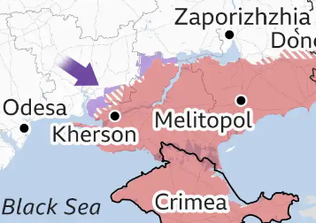
UNCLASSIFIED
Threats and Adversaries
ICOD:
10 0900 Aug22
Calm before the Storm?
UKR Prepares for Upcoming Counter-Offensive
Kherson & Zaporizhzhia Oblasts likely goals
Targeting Priorities; Logistics (ammunition sites & trains), Bridges, ADA, Command Posts
RUS Forces Prepare to Halt the UKR Offensive
Likely areas of UKR offensive
RUS has reinforced from forces elsewhere in occupied UKR
Local spoiling attacks likely to disrupt UKR forces
Limited attacks have been launched in Donbas / Kharkiv to divert UKR resources
The Counter-Offensive will Shape the Fight into the Fall and Winter
UNCLASSIFIED
Notes:
https://www.youtube.com/watch?v=jou9yL3AL1g
https://www.youtube.com/watch?v=T5cTJjN08mE
https://news.yahoo.com/first-time-ukraine-gains-chance-114400864.html?guccounter=1
https://www.theguardian.com/world/2022/jul/31/ukrainian-offensive-forces-russia-to-bolster-troops-in-occupied-south
https://www.bbc.com/news/world-europe-62340807

