Slide 1
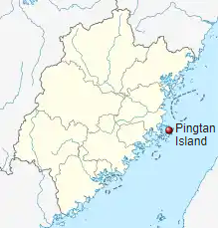
Threats and Adversaries
ICOD:
3 0900 Aug22
CODEL visit to Taiwan
PRC President warns of “external interference”
Xi warns Washington should not “play with fire’
Highest ranking CODEL since ‘97
CCP; has threatened China’s military will not “sit by idly”
PRC’s Response
China
‘Live-fire combat drills’ on Pingtan island off Fujian province
Aerial incursions in ADIZ, and two carrier drills
Taiwan’s Response
Han Kuang exercise; week-long joint exercise, presided by TWN President
Civil defense drills on response to air attack
145 nms
U.S’s Response
Pingtan Island
Closest part of Chinese ‘mainland’
to Taiwan
Relayed CODEL flight plans, goals, & ‘One China’ policy adherence
Reagan CSG w/F-35Bs deployed closer to Western Pacific
Visit will justify more hard line response from 20th Party Congress in OCT/NOV
RUS/UKR; both brief stand downs…relocated troops
13 RUS ad hoc BTG’s along a 252km line of battle in Kherson
Notes:
https://www.politico.com/news/2022/07/30/china-announces-military-exercise-opposite-taiwan-00048810
https://asia.nikkei.com/Politics/International-relations/Indo-Pacific/China-sends-39-aircraft-into-Taiwan-ADIZ-countering-big-U.S.-drill

