Slide 1
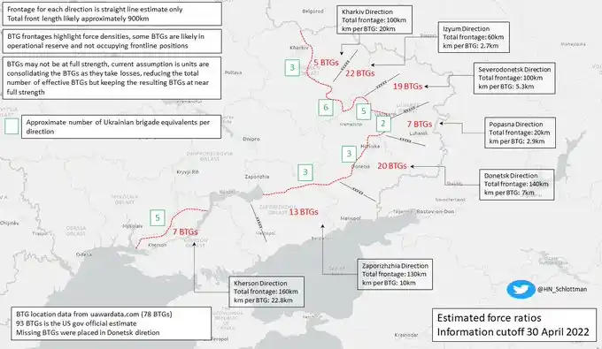
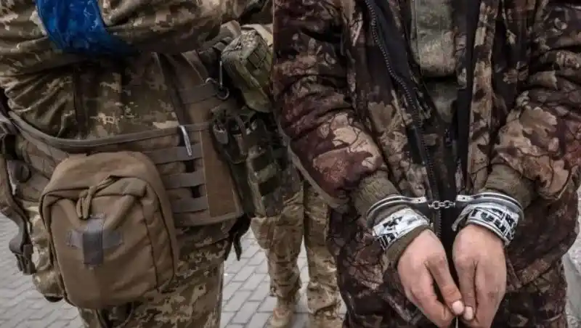
ICOD: 0900 18 OCT 22
UNCLASSIFIED
LSCO Challenges
Reconstituting and Regenerating Combat Losses During Extended High-Intensity Conflict
Russia’s People Problem
RUS Armed Forces lacked sufficient personnel depth for prolonged LSCO
Experiencing an estimated 100-200 soldiers KIA per day
Leadership and experience deficiencies exacerbated by high casualty rates among elite units and officers
Attrition Depleting Ready Reserves
Individual replacements made regardless of “military registration specialty”
Inability to rotate front-line units out of combat due to reserve unit shortage
Combat ineffective units merged or repurposed as smaller echelons
Individual BTGs responsible for front line sectors up to 20 km wide
RUS BTG Frontages
Russia Struggling to Regenerate Manpower
Need for rapidly deployable forces resulting in undertrained troops and units
Use of National Guard and PMC Wagner to offset RF AF manpower shortages
RUS MoD decentralized recruiting, outsourcing efforts to regional governments
Partial mobilization and changes to RUS Criminal Code enabling more aggressive force regeneration measures
Voluntary Surrender Now a Crime for RUS Troops
Russia’s struggles with the reconstitution and regeneration of forces are challenges the U.S. Army could face in extended, high-intensity LSCO.
UNCLASSIFIED

