Slide 1
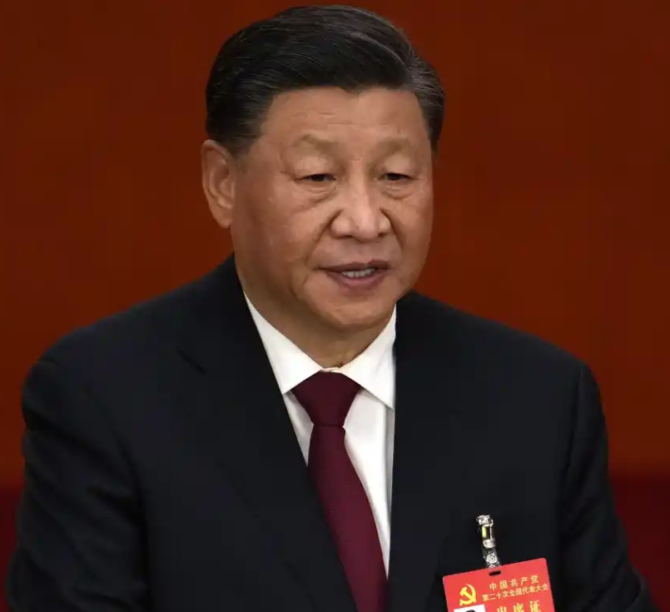
UNCLASSIFIED
Threats and Adversaries
ICOD:
25 0900 Oct22
President Xi Jinping Addresses 20th Party Congress
Four Key Points:
“Zero COVID Policy” Remains China’s Policy
Called for a “People’s War” to halt spread
Economic Development a National Priority
Worst economic performance since 1976
More centralization likely
Taiwan Unification “Must be Realized”
More urgency over next five years
More assertive on Globally
“Strategic Opportunities” to pursue influence
Xi on Taiwan
“Complete reunification of our country must be realized, and it can, without doubt be realized.”
“We will continue to strive for peaceful reunification…but we will never promise to renounce the use of force.”
Xi’s speech hints at a more assertive China regionally and globally; ambitions could be challenged by economic factors.
UNCLASSIFIED

