Slide 1
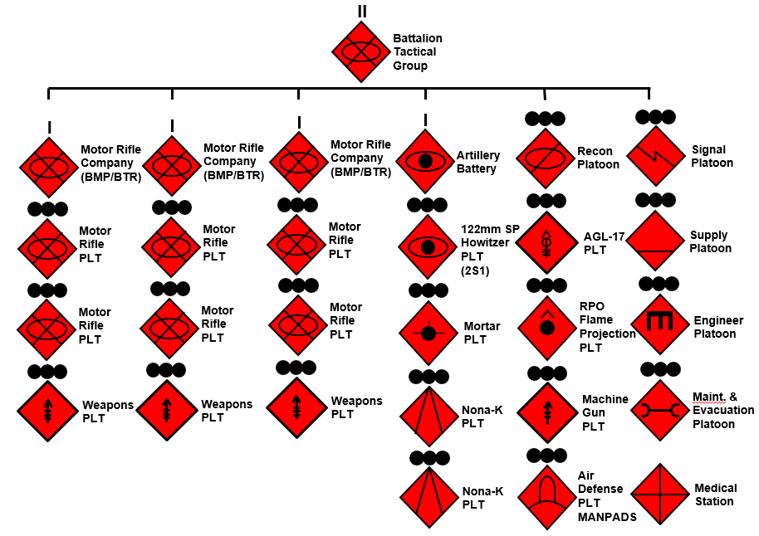
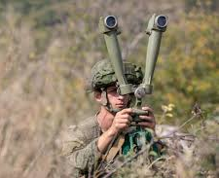
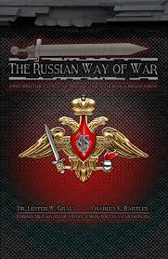
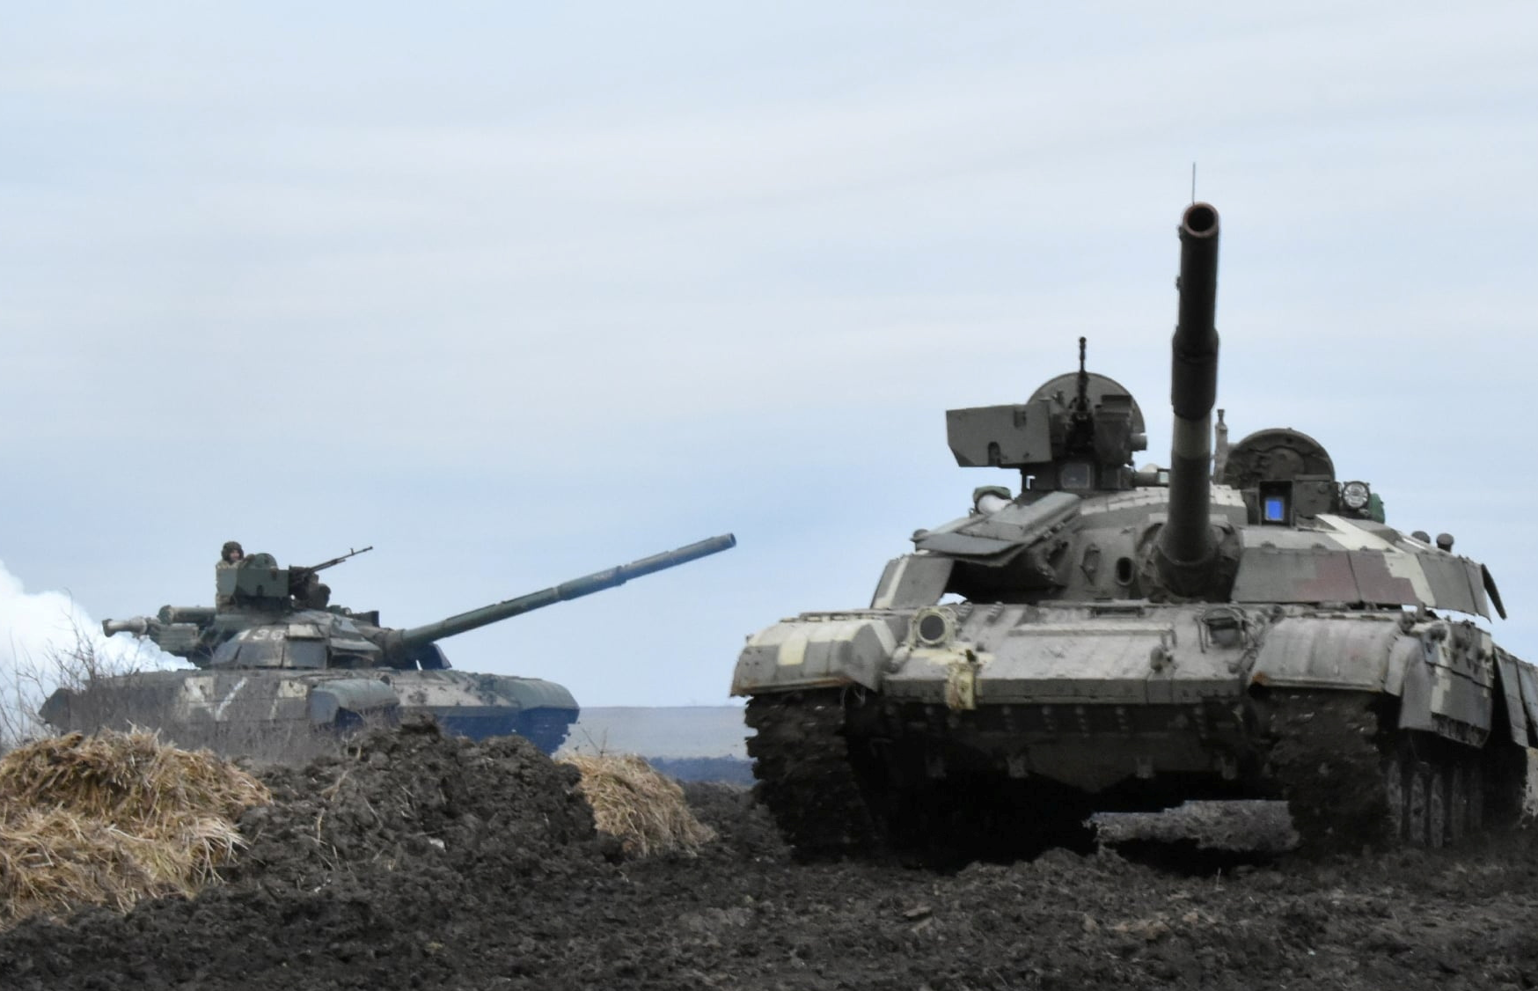
Russian Battalion Tactical Group (BTG)
BTG Organizational Structure
Primary building blocks for tactical operations
Equipped with Joint assets and/or niche equipment (EW jammers, tactical UAVs, SIGINT, and HUMINT)
Operational BTGs gain active-protection systems and explosive reactive armor
Often field a brigade complement of artillery that may overmatch U.S. BCTs
Russia has approximately 160 total BTGs
Russian Battalion Tactical Groups can be employed rapidly and execute operations without additional external support. When employed with reconnaissance assets, they may carry out Russia’s Recon Strike operations.

