Slide 1
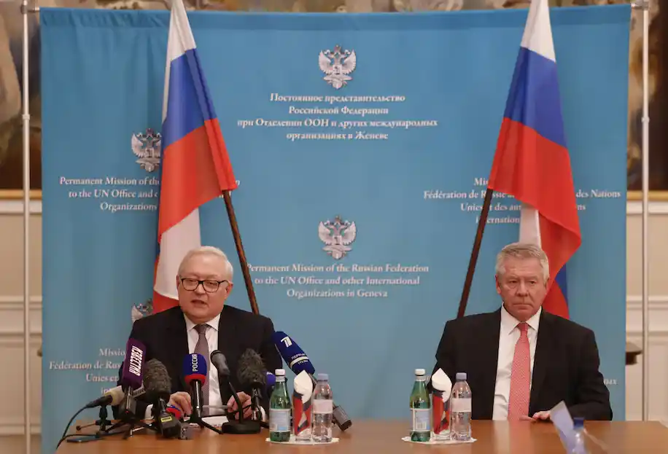
Russia and Ukraine Update
Current Situation
Diplomatic
Bilateral Russian and U.S talks continue despite minimal progress
JAN12th NATO-Russia talks in Brussels
JAN13th Organization for Security and Cooperation in Europe (OSCE) in Vienna
Information
Russia denies planning offensive and blames U.S. and NATO for undermining security in the region
Military
Russian BTGs near Ukrainian border & Belarus
~100K Ground Troops
~22K Air and Naval Forces
~3K Russian Troops conduct live-fire exercise near Ukraine in Western Russia
Economic
G7 warns Russia to de-escalate or face severe economic response
U.S. and Russian Strategic Stability Dialogue
U.S. and Russian negotiations on Jan 10, 2022
Russia’s deputy foreign ministers in Geneva on Jan 10, 2022
Strategic negotiations unlikely to resolve situation, Russia remains poised to act

