Slide 1

Resources for
Studying China
Peter Wood
TRADOC G-2 – Foreign Military Studies Office
July 2022
This briefing is UNCLASSIFIED
Approved for public release. Distribution is unlimited
Notes:
PLA Logo via Wikimedia Commons https://commons.wikimedia.org/wiki/File:China_Emblem_PLA.svg

Slide 2
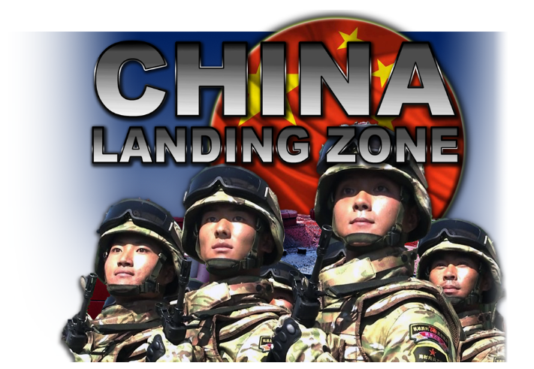
Central repository of TRADOC G-2 and Army resources on China
https://oe.tradoc.army.mil/how-china-fights/
This briefing is UNCLASSIFIED

Slide 3

Foreign Military Studies Office
FMSO's Operational Environment Watch provides translated selections and analysis from a diverse range of foreign articles and other media that our analysts believe will give military and security experts an added dimension to their critical thinking about the Operational Environment
https://community.apan.org/wg/tradoc-g2/fmso/
This briefing is UNCLASSIFIED

Slide 4
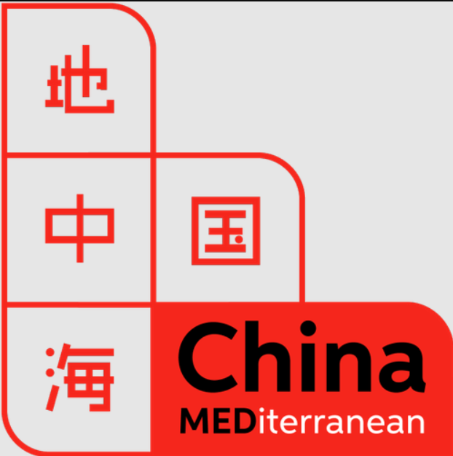





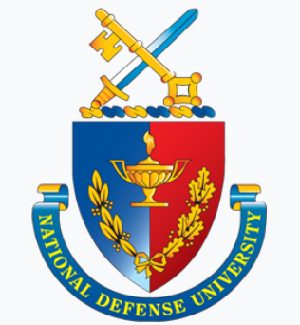







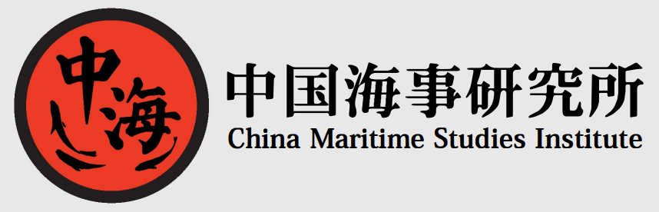

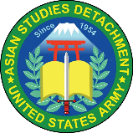

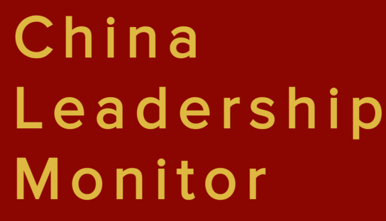



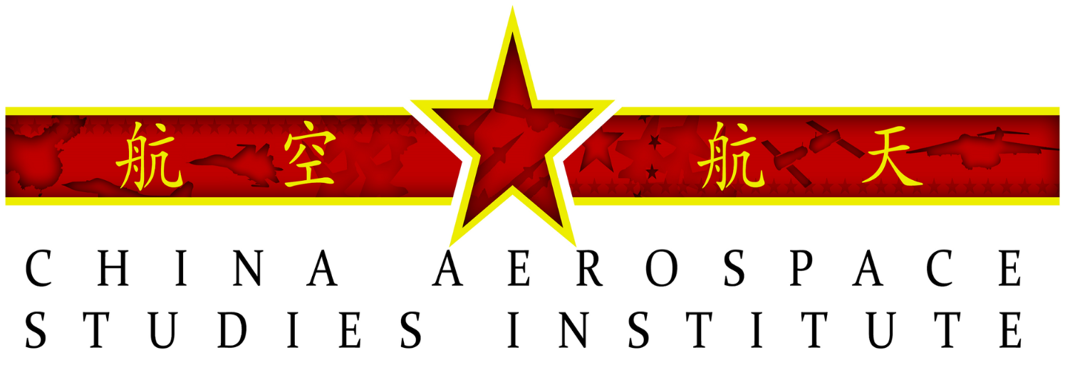


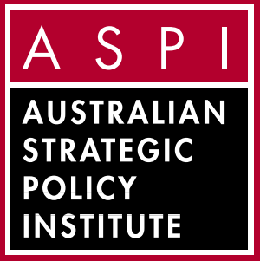
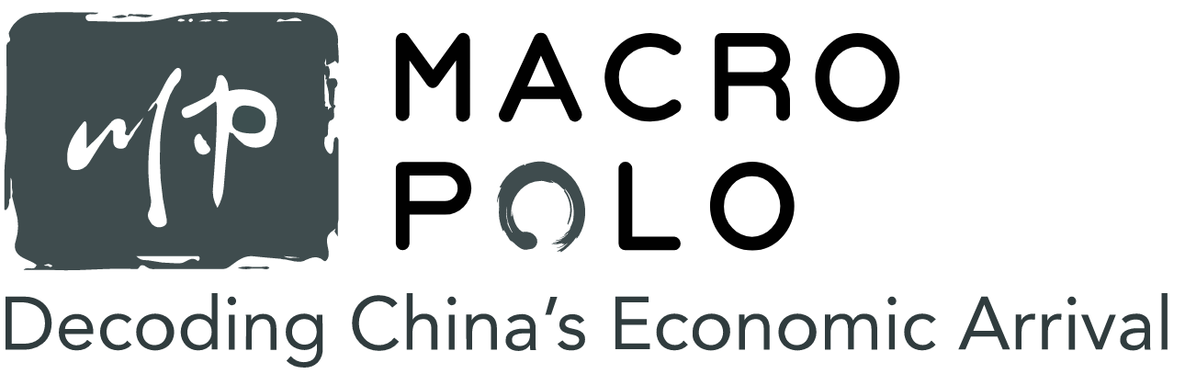


Reliable Sources of Analysis
Politics & Foreign Policy
Center for the Study of Chinese Military Affairs
Economics & Development
OE
Watch
Military
UC San Diego/Study of Innovation and Technology in China
This briefing is UNCLASSIFIED
Technology & Innovation
Notes:
Does not include blogs, newsletters, or think that largely focus on U.S. policy (CNAS), or those that only sporadically have China content, or do not have a direct regional focus as Johns Hopkins APL (https://www.jhuapl.edu/NewsPublications/Publications ) which has had excellent, but periodic or project focused coverage

Slide 5
Resources
Operational Environment Watch | https://community.apan.org/wg/tradoc-g2/fmso/
China Landing Zone (TRADOC G-2 Portal) | https://oe.tradoc.army.mil/how-china-fights/
Asian Studies Detachment (US Army) | Available via CAC-enabled portals
Military
Asia Maritime Transparency Initiative (CSIS) | https://amti.csis.org/
China Maritime Studies Institute (USN) | https://usnwc.edu/Research-and-Wargaming/Research-Centers/China-Maritime-Studies-Institute
China Aerospace Studies Institute (USAF) | https://www.airuniversity.af.edu/CASI/
Center for the Study of Chinese Military Affairs (NDU) | https://inss.ndu.edu/
RAND (FFRDC) ^{[1]} | https://www.rand.org/topics/china.html
Carnegie Endowment for International Peace | https://carnegieendowment.org/regions/251
Politics & Foreign Policy
China Brief (Jamestown Foundation) | https://jamestown.org/programs/cb/
ChinaMed | https://www.chinamed.it/
China-Global South Project | https://chinaglobalsouth.com/
China Leadership Monitor | https://www.prcleader.org/
German Marshall Fund (GMF) | https://www.gmfus.org/asia-program
China Media Project | https://chinamediaproject.org/
ChinaPower (CSIS)/ CSIS: Interpret China | https://chinapower.csis.org/ ; https://interpret.csis.org/translations
ChinaVitae | https://www.chinavitae.com/
ChinaFile (Asia Society Blog) | https://www.chinafile.com/
National Bureau of Asian Research | https://www.nbr.org/
Technology & Innovation
Australian Strategic Policy Institute | https://www.aspi.org.au/
Center for Security & Emerging Technology (CSET) | https://cset.georgetown.edu/
C4ADS | https://c4ads.org/reports
UC San Diego – Institute for Study of Innovation and Technology in China | https://escholarship.org/uc/igcc_sitc (old); https://ucigcc.org/category/publication/
Economics & Development
MacroPolo | https://macropolo.org/
Peterson Institute for International Economics | https://www.piie.com/research/china
U.S-China Economic & Security Review Commission (Congress) | https://www.uscc.gov/research
Stanford Center on China’s Economy and Institutions | https://sccei.fsi.stanford.edu/
This briefing is UNCLASSIFIED
^{[1]} Federally Funded Research and Development Centers
Notes:
Collected by Peter Wood. Most sources report on multiple topics--categories are not absolute. The following is intended purely as a resource to assist with research on China and inclusion does not imply endorsement of any position taken by the included institution and publications.

Slide 6
Essential Reading on the PLA
Joel Wuthnow et. al, Eds. Crossing the Strait China’s Military Prepares for War with Taiwan, National Defense University 2022. https://ndupress.ndu.edu/Portals/68/Documents/Books/crossing-the-strait/crossing-the-strait.pdf
Joel Wuthnow et. al, The PLA Beyond Borders: Chinese Military Operations in Regional and Global Context, NDU, 2019 https://ndupress.ndu.edu/Portals/68/Documents/Books/beyond-borders/990-059-NDU-PLA_Beyond_Borders_sp_jm14.pdf
Roger Cliff, Roy Kamphausen et.al., Enabling a More Externally Focused and Operational PLA – 2020 PLA Conference Papers (Carlisle Barracks, PA: US Army War College Press, 2022), https://press.armywarcollege.edu/monographs/951
Roy Kamphausen, The People of the PLA 2.0 (US Army War College Press, 2021), https://press.armywarcollege.edu/monographs/944
6

Slide 7
Recommended Podcasts & Newsletters
Podcasts:
Drumtower by The Economist - short, less formal and often funny takes by The Economist's China team. Always informative and goes beyond the news to cover cultural issues as well which keeps it interesting. https://podcasts.apple.com/us/podcast/drum-tower/id1651657142
The China History Podcast - long running series by a businessman who has lived and worked in China for years that covers huge amount of interesting topics. I first started listening to this when I was a grad student in China over a decade ago so plenty of content. From the history of Tea to Taiwan (which they did a 15[!] -part series on) they've got you covered - https://podcasts.apple.com/us/podcast/the-china-history-podcast/id489369498
Newsletters /Blogs
Tracking People's Daily which provides detailed analysis of People’s Daily (the main CCP mouthpiece newspaper) https://trackingpeoplesdaily.substack.com/
Discourse Power - a great effort by Israeli scholar Tuvia Gering which does detailed analysis of CCP global Information Operations https://discoursepower.substack.com/
US thinktank Center for Naval Analyses now does a semi-regular roundup of important news on the PLA - https://www.cna.org/our-media/newsletters/pla-update
Disclaimer: The views expressed in each podcast are those of the author and do not represent the official policy or position of the Department of the Army, Department of Defense, or the US Government. Release of this information does not imply any commitment or intent on the part of the US Government to provide any additional information on any topic presented herein. The appearance of hyperlinks does not constitute endorsement by the US Army of the referenced site or the information, products, or services contained therein. Users should exercise caution in accessing hyperlinks.

Slide 8
Recommended Reading:
CCP Intelligence & Influence Operations
Books
Joske, Alex. Spies and Lies: How China's Greatest Covert Operations Fooled the World. Hardie Grant Books, 2022.
Peter Mattis & Matthew Brazil, Chinese Communist Espionage: An intelligence primer, Naval Institute Press, Annapolis, MD, 2019
Roger Faligot, Chinese Spies: From Chairman Mao to Xi Jinping, Scribe, Melbourne, 2019
Eftimiades, Nicholas. Chinese Espionage: Operations and Tactics. Vitruvian Press, 2020.
Cheng, Ganyuan. Secrets Of The CCP’s United Front Work Department: Memoir Of A United Front Cadre. Citizen Power Initiatives for China, 2019. Note: More historical as it largely covers the 60s and 70s and the United Front mission within China, but still helpful as it is a first-hand account.
Articles and Reports
Peter Mattis, ”China's Military Intelligence System is Changing," War on the Rocks, 29 December 2015. https://warontherocks.com/2015/12/chinas-military-intelligence-system-is-changing/
Russell Hsiao, “A preliminary survey of CCP influence operations in Japan.” China Brief, 26 June 2019, https://www.jamestown.org/program/a-preliminary-survey-of-ccp-influence-operations-in-japan/
Alex Joske, “Reorganizing the United Front Work Department: New structures for a new era of diaspora and religious affairs work’, China Brief, 9 May 2019, https://www.jamestown.org/program/reorganizing-the-united-front-work-department-new-structures-for-a-new-era-of-diaspora-and-religious-affairs-work/
Gerry Groot, ‘The rise and rise of the United Front Work Department under Xi’, China Brief, April 2018, https://www.jamestown.org/program/the-rise-and-rise-of-the-united-front-work-department-under-xi/
Anne-Marie Brady, ‘Magic weapons: China’s political influence activities under Xi Jinping’, Wilson Center, September 2017, www.wilsoncenter.org/article/magic-weapons-chinas-political-influence-activities-under-xi-jinping
Alex Joske, ‘Secret police: The Ministry of Public Security’s clandestine foreign operations’, Sinopsis, 25 January 2022,https://sinopsis.cz/wp-content/uploads/2022/01/mps0.pdf
Mark Stokes & Russell Hsiao, The People’s Liberation Army General Political Department: Political warfare with Chinese characteristics, Project 2049 Institute, Arlington, VA, October 2013, https://project2049.net/2013/10/14/the-peoples-liberation-army-general-political-department-political-warfare-with-chinese-characteristics/
8

Slide 9
UNCLASSIFIED
Recommended Reading on Taiwan
General Resources
Excellent collection of resources available on Stanford Prof Kharis Templeman's website https://www.kharistempleman.com/taiwan-studies-resources.html
Taiwanese Politics and Society
Bush, Richard C. Difficult Choices: Taiwan's Quest for Security and the Good Life. Brookings Institution Press, 2021.
Fell, Dafydd. Government and Politics in Taiwan. Taylor and Francis, 2018.
"Statistical Yearbook of the Republic of China - 2021," Directorate General of Budget, Accounting and Statistics, Executive Yuan, ROC, September 2022. https://ws.dgbas.gov.tw/public/data/dgbas03/bs2/yearbook_eng/yearbook2021.pdf
Comment: Blogs, programs and publications wax in wane in quality, frequency of output and even editorial bias. The following are some of the most prominent or easy to access sources on Taiwan but they may have issues. Caveat emptor.
The University of Nottingham's Taiwan Studies Program has a blog with regular coverage of topics of interest https://taiwaninsight.org/
Global Taiwan Institute is a non-profit with strong links to the DPP. It has regular coverage of mainland and Taiwan security issues. https://globaltaiwan.org/
If you want to learn more about Taiwanese elections I recommend Nathan Batto’s blog Frozen Garlic (it’s a pun in Chinese) https://frozengarlic.wordpress.com
UNCLASSIFIED

Slide 10
UNCLASSIFIED
Please exercise caution when accessing foreign websites (esp. Taiwan MND) with NIPR computers. When possible, use Google Cached versions etc and a VPN
Primary Sources:
“Taiwan Quadrennial Defense Review: The Republic of China (2021)," ROCMND, March 2021. https://www.ustaiwandefense.com/tdnswp/wp-content/uploads/2021/03/2021-Taiwan-Quadrennial-Defense-Review-QDR.pdf
ROC National Defense Report 2021, ROC MND, 2021. https://www.ustaiwandefense.com/tdnswp/wp-content/uploads/2021/11/Taiwan-National-Defense-Report-2021.pdf
Book:
Easton, Ian. The Chinese Invasion Threat: Taiwan’s Defense and American Strategy in Asia. Eastbridge Books, 2017.
NDU Conference series on Taiwan invasion scenarios:
Joel Wuthnow et. al, Eds. Crossing the Strait China’s Military Prepares for War with Taiwan, National Defense University 2022. https://ndupress.ndu.edu/Portals/68/Documents/Books/crossing-the-strait/crossing-the-strait.pdf
Excellent conference papers by the China Maritime Studies Institute
Lonnie D. Henley, Beyond the First Battle: Overcoming a Protracted Blockade of Taiwan, US Naval War College - China Maritime Studies Institute, 8 March 2023, https://digital-commons.usnwc.edu/cgi/viewcontent.cgi?article=1025&context=cmsi-maritime-reports
Tom Fox, "The PLA Army's New Helicopters: An "Easy Button" for Crossing the Taiwan Strait?," US Naval War College - China Maritime Studies Institute, 20 December 2021, https://digital-commons.usnwc.edu/cgi/viewcontent.cgi?article=1016&context=cmsi-maritime-reports
Kevin McCauley, Logistics Support for a Cross-Strait Invasion: The View from Beijing, US Naval War College - China Maritime Studies Institute, https://digital-commons.usnwc.edu/cgi/viewcontent.cgi?article=1021&context=cmsi-maritime-reports
Dennis J. Blasko, The PLA Army Amphibious Force, US Naval War College - China Maritime Studies Institute, 27 April 2022. https://digital-commons.usnwc.edu/cgi/viewcontent.cgi?article=1019&context=cmsi-maritime-reports
Cristina Garafola, "The PLA Airborne Corps in a Joint Island Landing Campaign," US Naval War College - China Maritime Studies Institute, 10 March 2022, https://digital-commons.usnwc.edu/cgi/viewcontent.cgi?article=1018&context=cmsi-maritime-reports
John Chen, Joel Wuthnow, "Chinese Special Operations in a Large-Scale Island Landing," US Naval War College - China Maritime Studies Institute, 21 January 2022, https://digital-commons.usnwc.edu/cgi/viewcontent.cgi?article=1017&context=cmsi-maritime-reports
Conor Kennedy, The New Chinese Marine Corps: A "Strategic Dagger" in a Cross-Strait Invasion, US Naval War College - China Maritime Studies Institute, 13 October 2021, https://digital-commons.usnwc.edu/cgi/viewcontent.cgi?article=1014&context=cmsi-maritime-reports
UNCLASSIFIED

Slide 11




UNCLASSIFIED
Taiwanese Media Landscape
Central News Agency (CNA)/
Focus Taiwan (english edition)
https://www.cna.com.tw/
https://focustaiwan.tw/
NGO-run News Agency
Government-produced
military-focused news
https://www.ydn.com.tw/
Liberty Times/ Taipei Times https://www.ltn.com.tw/
http://taipeitimes.com/
United Daily News
https://udn.com/
Pro-KMT
Pro-DPP
China Times
www.chinatimes.com/
Owned by Mainland-aligned commercial group
Pro-Mainland/Mainland-backed
UNCLASSIFIED
Notes:
Part of analytic rigor is keeping in mind who you are citing and what their editorial biases might be

